Slide 1
Unemployment
Pub 17 Chapter 12
(Federal 1040-line 19)
Notes:
1

Slide 2
Unemployment
Unemployment is taxable for Federal return
Unemployment is not taxable in NJ
TaxSlayer handles automatically
End-of-year tax statement:
1099-G Statement for Certain Government Payments
Notes:
2

Slide 3
1099-G for Unemployment
1099-G not mailed to taxpayer; must look up info on NJ Dept. of Labor website
Site is: http://lwd.state.nj.us/labor/ui/content/1099G.html OR
Link from TaxPrep4Free.org Preparer page: NJ Form 1099-G Inquiry (Unemployment)
Taxpayer must have a user name, password & PIN to view/print 1099-G

Slide 4
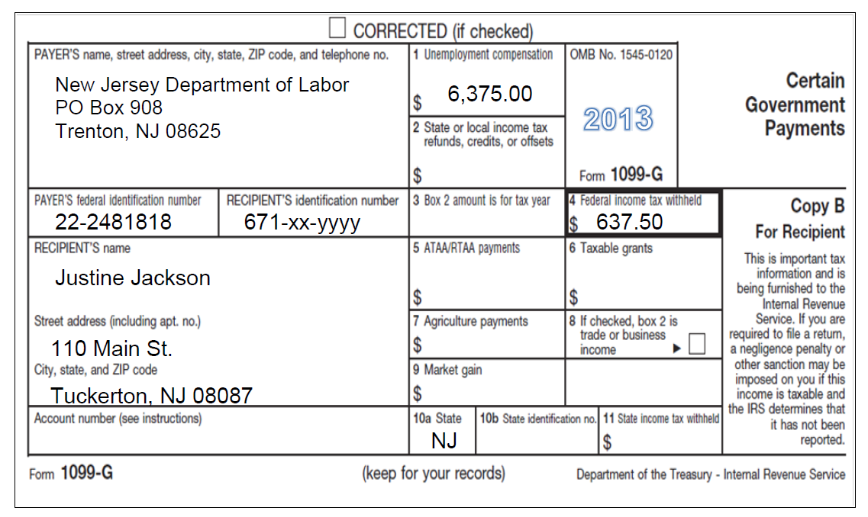
Sample 1099-G Unemployment Income
2016
Unemployment compensation
Federal tax withheld

Slide 5
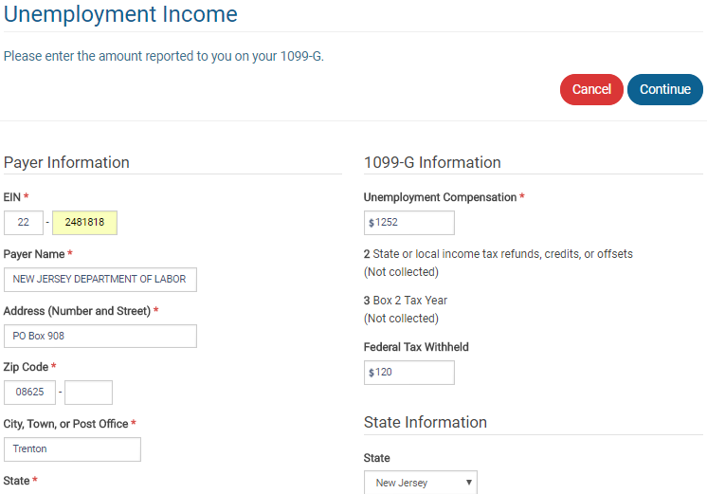
TS - Unemployment Benefits - 1099-G Federal section \ Income \ Enter Myself \ Unemployment Compensation (1099-G Box 1) \ Add or Edit a 1099-G
TaxSlayer transfers to 1040 Line 19
TaxSlayer includes in 1040 Line 64
Notes:
5

Slide 6
TS - Unemployment Benefits on 1040 Line 19
TaxSlayer transfers from 1099-G
Notes:
TaxSlayer transfers unemployment income from 1099-G screen to 1040 Line 19
6

